Slide 1

Data science steps

Slide 2
Objectives
Import datasets
Data wrangling
Exploratory data analysis
Model development
Model evaluation and refinement
Data science steps

Slide 3
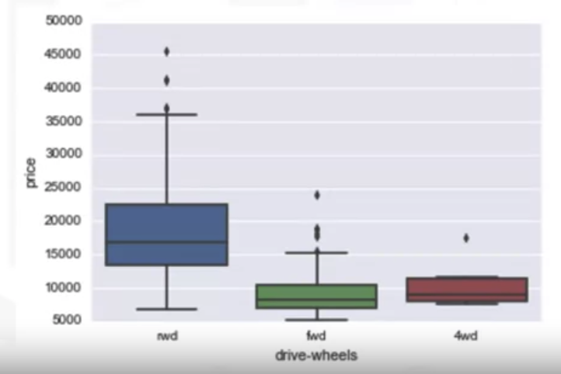
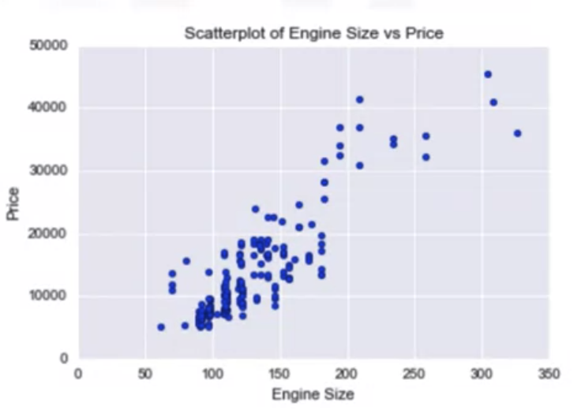
Exploratory data analysis- Describe
Describe basic features of data: df.describe()
Giving short summaries about the sample and measures of data
Using Box plot or Scatter plot
Data science steps

Slide 4
Exploratory data analysis- Grouping
Grouping data:
  Assume you want to know, is there any relationship between the different types of drive system, forward, rear, and four-wheel drive, and the price of the vehicles?
  If so, which type of drive system adds the most value to a vehicle?
  It would be nice if we could group all the data by the different types of drive wheels and compare the results of these different drive wheels against each other.
Using df.groupby()
Using pd.pivot()
Data science steps

Slide 5
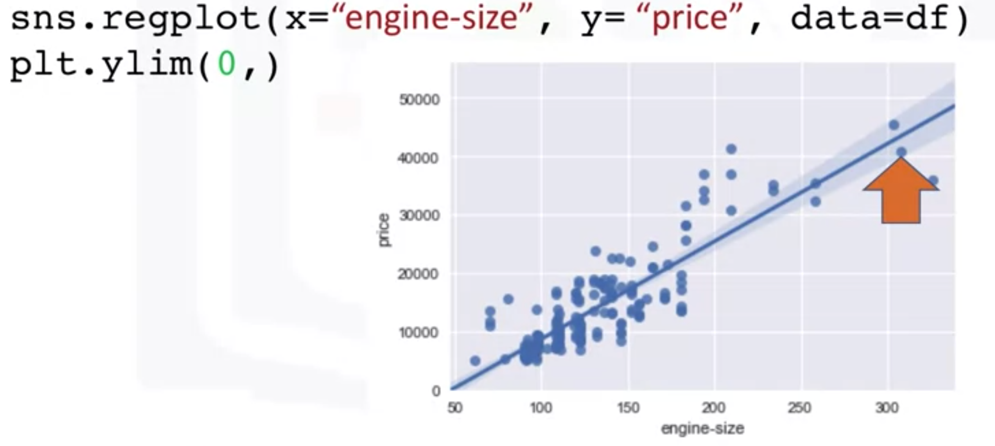
Exploratory data analysis- Correlation
Correlation is a measurement to what wxtent different variables are interdependent
For example:
  Lung cancer→ Smoking
  Rain → umbrella
Correlation does not imply causation
Correlation between two feature( engine- size and price)
Data science steps

Slide 6
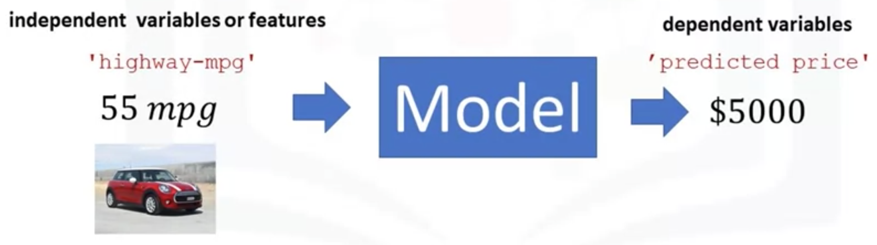
Exploratory data analysis- Model development
A model can be thought of as mathematical equation used to predict a value give one or more values
Relating one or more independent variables to dependent variables
Data science steps

Slide 7
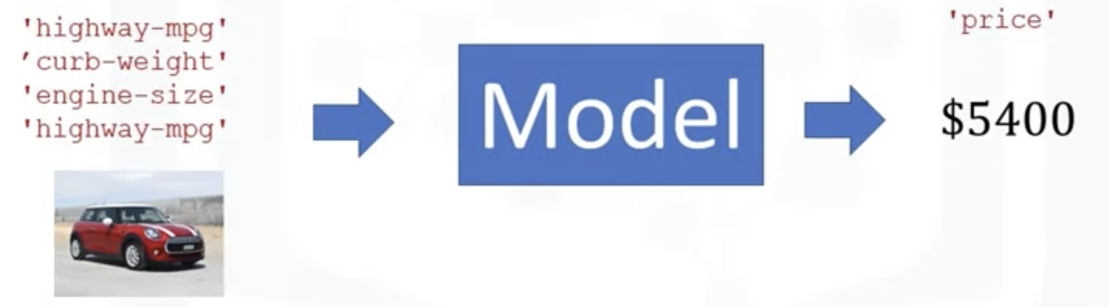
Exploratory data analysis- Model development
Usually, the more relevant data you have, the more accurate your model is.
Data science steps

Slide 8
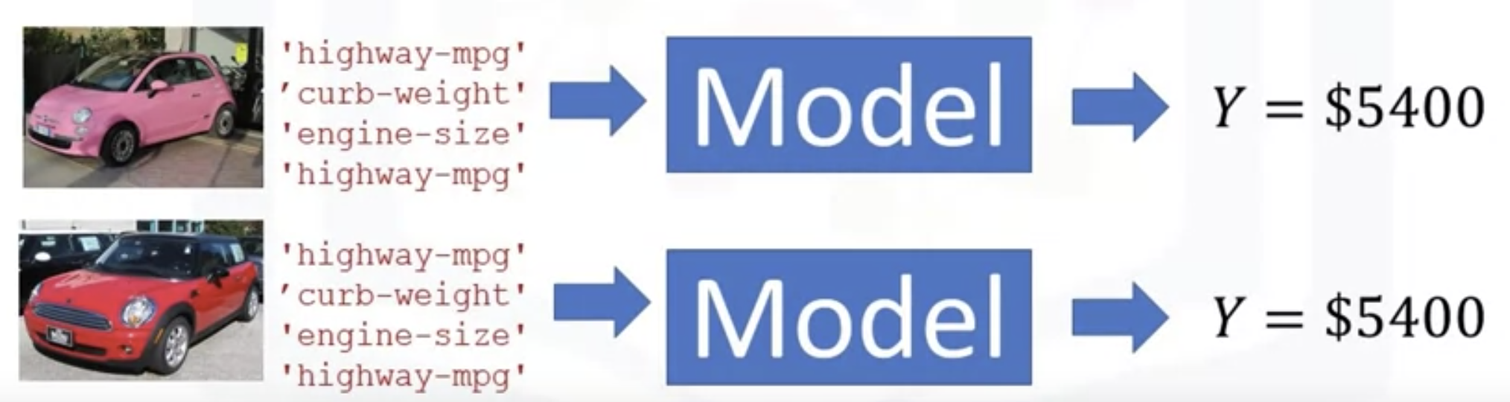
Exploratory data analysis- Model development
More data is important:
  More value data→ increate accuracy.
Data science steps

Slide 9
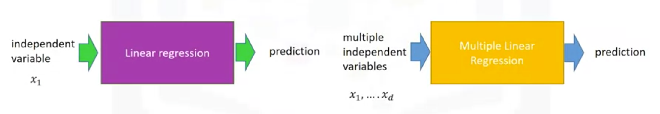
Exploratory data analysis- Model development
Linear regression will refer to one independent variable to make a prediction. Multiple linear regression will refer to multiple independent variables to make a prediction.
Data science steps

Slide 10
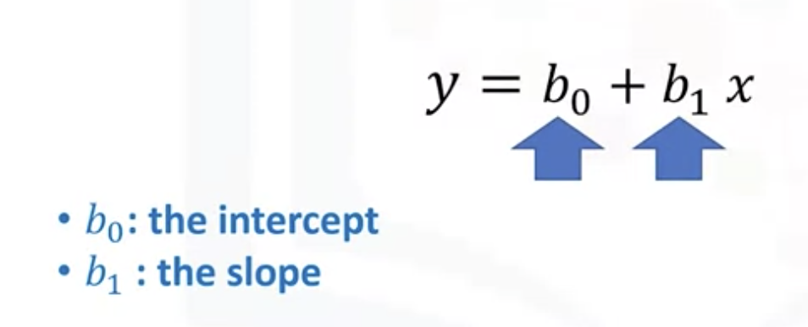
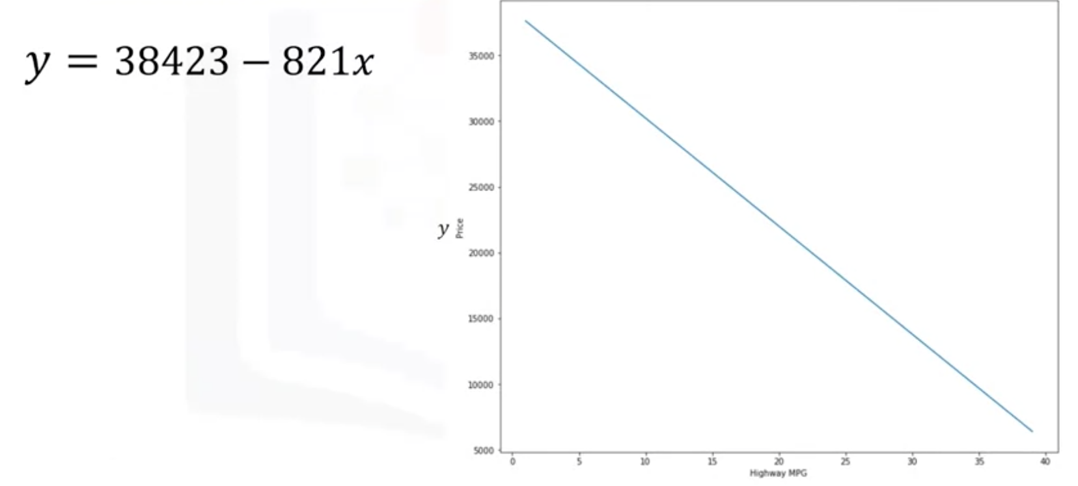
Exploratory data analysis- Model development
Simple linear regression or SLR is a method to help us understand the relationship between two variables.
The predictor independent variable x and the target dependent variable y.
Data science steps

Slide 11
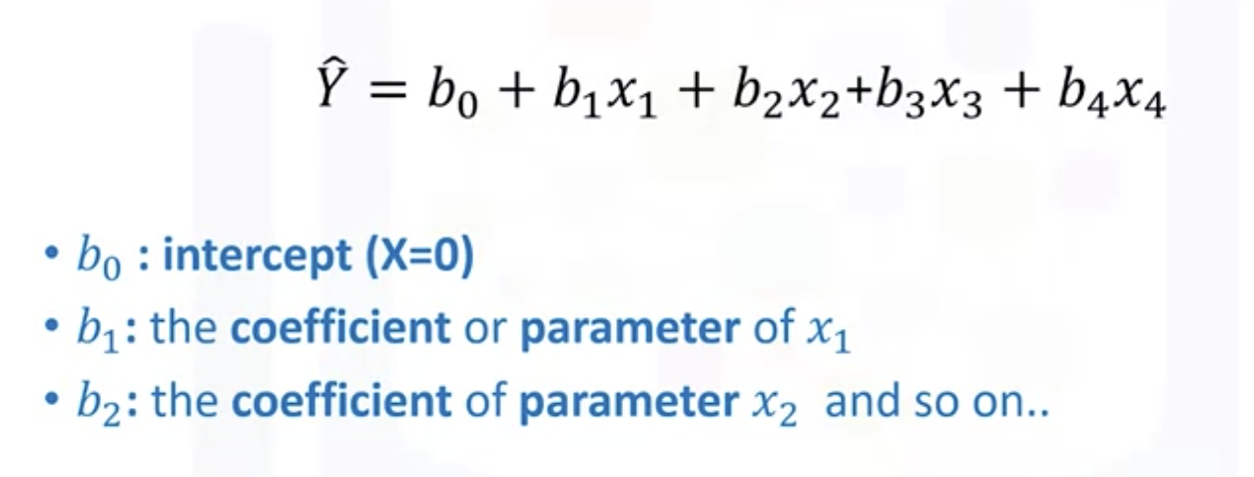
Exploratory data analysis- Model development
Multiple linear regression is used to explain the relationship between one continuous target y variable and two or more predictor x variables.
Data science steps

Slide 12
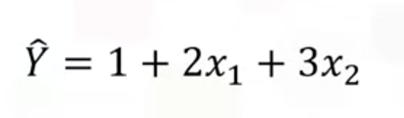
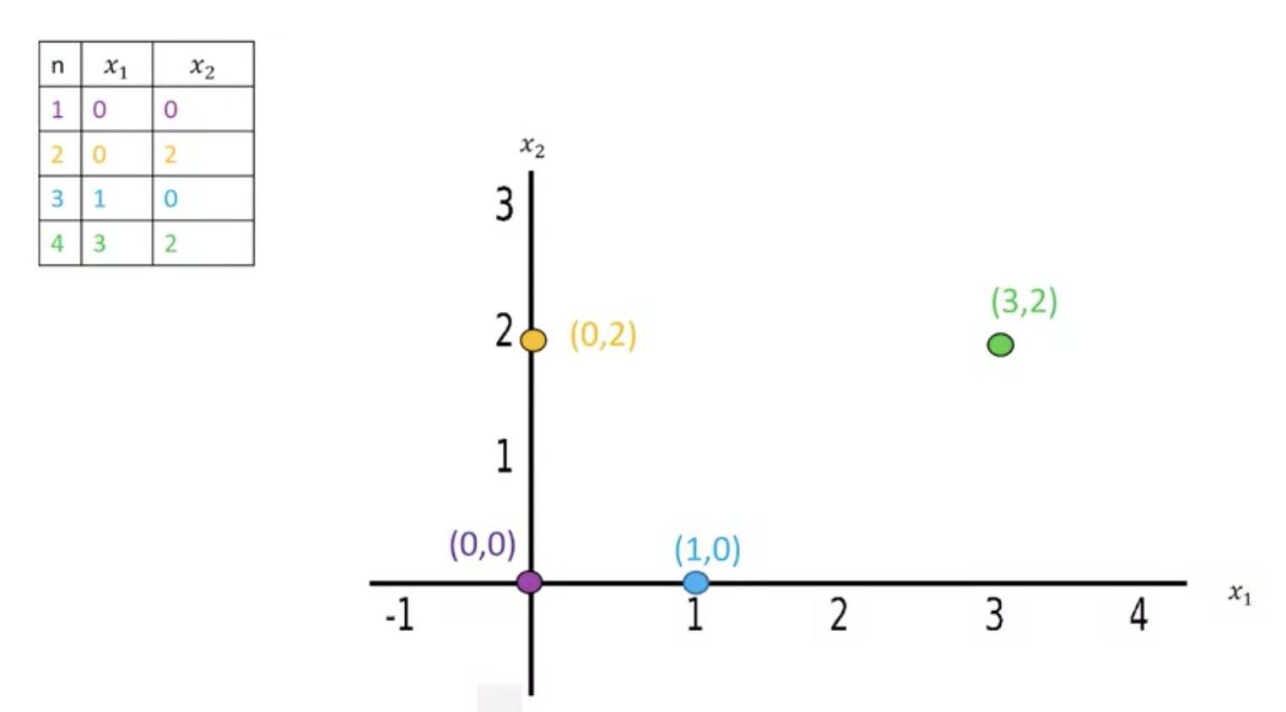
Exploratory data analysis- Model development
The variables x_1 and x_2 can be visualized on a 2D plane.
Data science steps

Slide 13
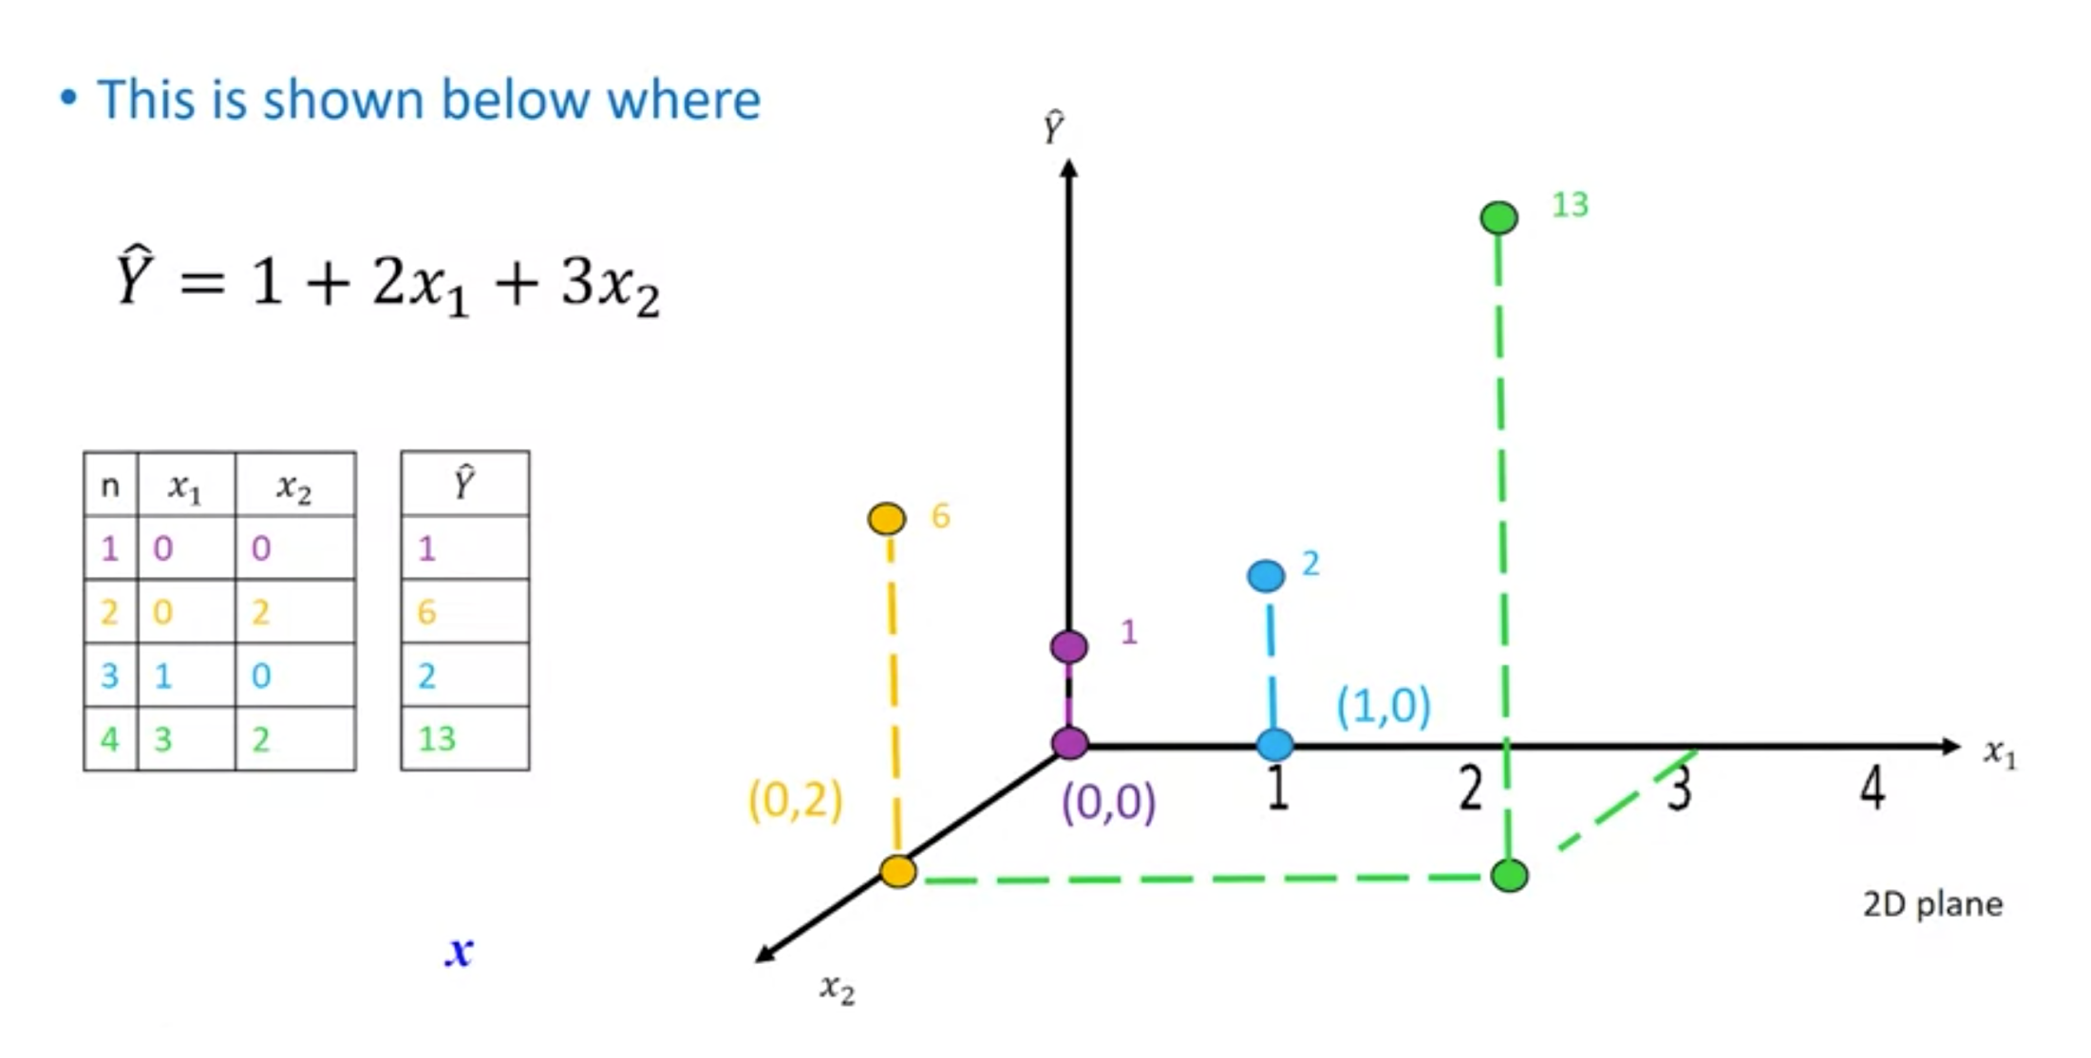
Exploratory data analysis- Model development
Data science steps

Slide 14
Exploratory data analysis
The measures that we use for in-sample evaluation. These measures are a way to numerically determine how good the model fits on our data.
Two important measures that we often use to determine the fit of a model are:
  Mean Square Error (MSE)
  R-squared.
Data science steps

Slide 15
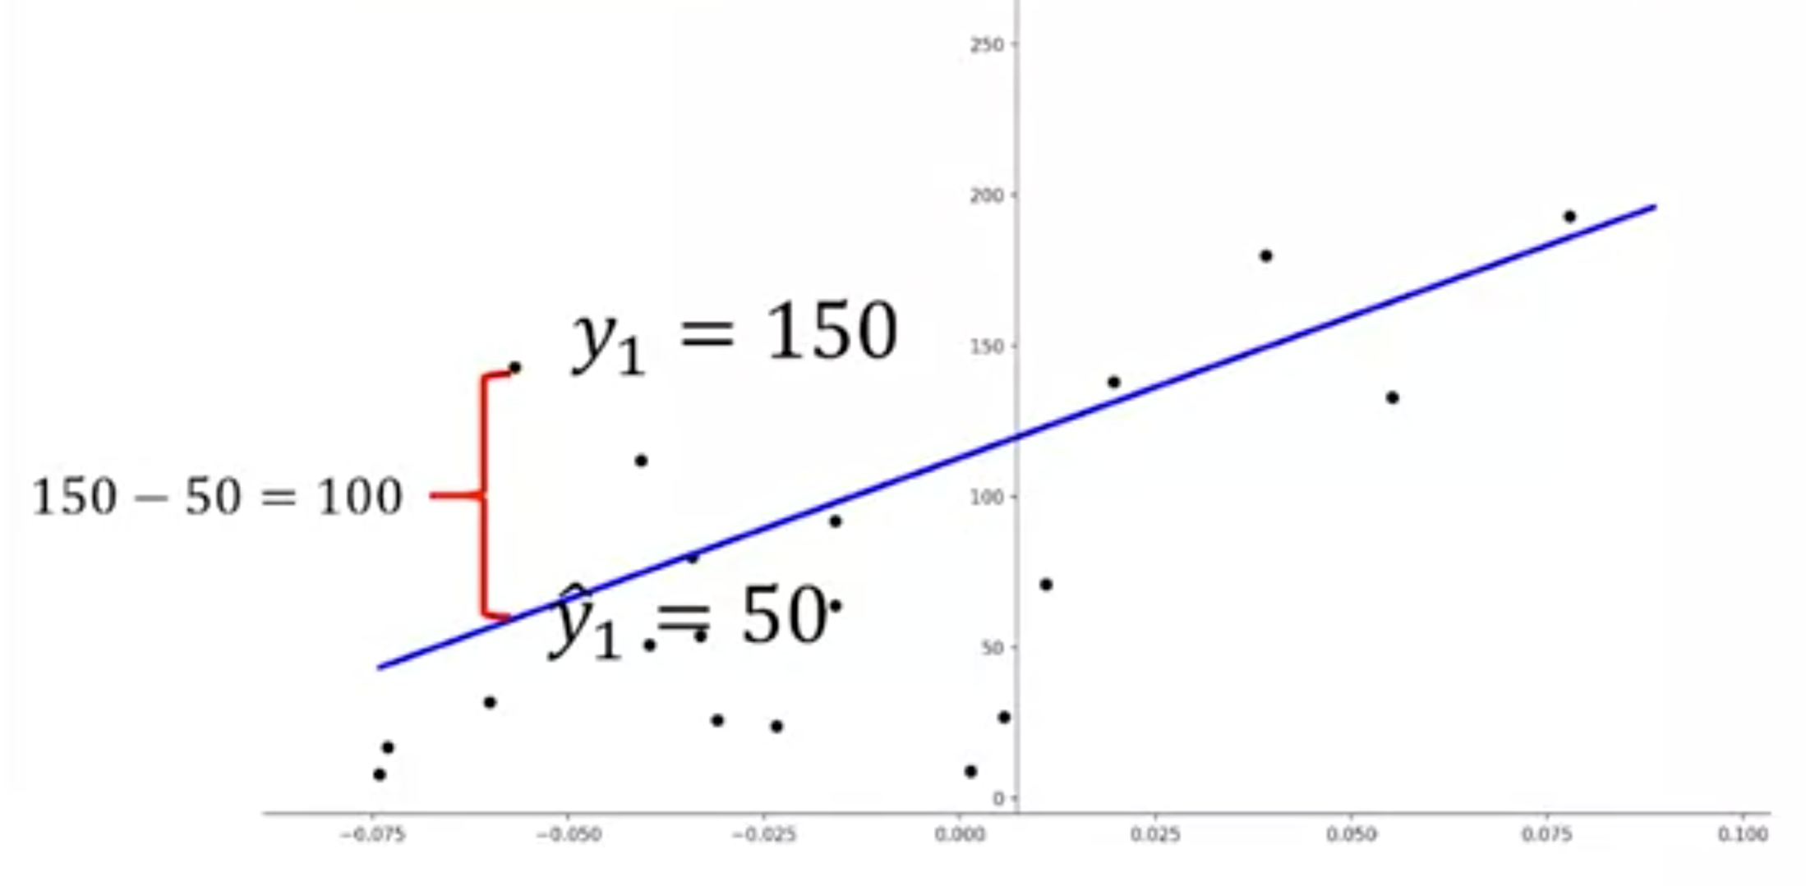
Exploratory data analysis
To measure the MSE, we find the difference between the actual value y and the predicted value yhat then square it.
Data science steps
Notes:
In this case, the actual value is 150; the predicted value is 50. Subtracting these points we get 100. We then square the number. We then take the Mean or average of all the errors by adding then all together and dividing by the number of samples

Slide 16
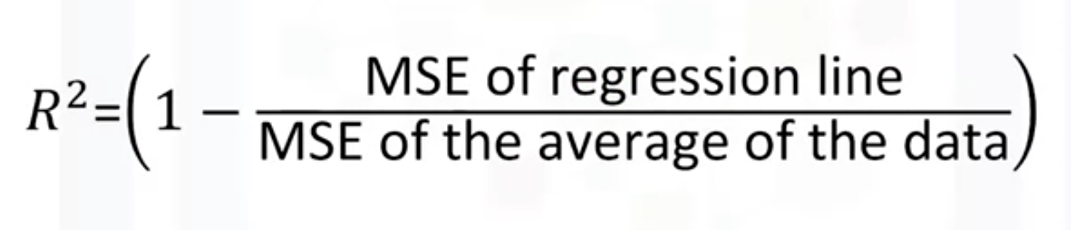
Exploratory data analysis
R-squared is also called the coefficient of determination.
It’s a measure to determine how close the data is to the fitted regression line. So how close is our actual data to our estimated model?
Think about it as comparing a regression model to a simple model, i.e., the mean of the data points.
If the variable x is a good predictor our model should perform much better than just the mean
Data science steps

Slide 17
Model Evaluation and Refinement
How can we determine if our model is correct?
The first thing you should do is make sure your model results make sense.
  You should always use visualization
  numerical measures for evaluation
  comparing between different models.
Data science steps

Slide 18
Model Evaluation and Refinement
Model evaluation tells us how our model performs in the real world.
In-sample evaluation tells us how well our model fits the data already given to train it.
It does not give us an estimate of how well the train model can predict new data.
The solution is to split our data up, use the in-sample data or training data to train the model.
The rest of the data, called Test Data, is used as out-of-sample data. This data is then used to approximate, how the model performs in the real world.
Data science steps

Slide 19
Model Evaluation and Refinement
We can use 70 percent of the data for training.
We then use 30 percent for testing.
We use training set to build a model and discover predictive relationships.
We then use a testing set to evaluate model performance.
When we have completed testing our model, we should use all the data to train the model.
Data science steps

Slide 20
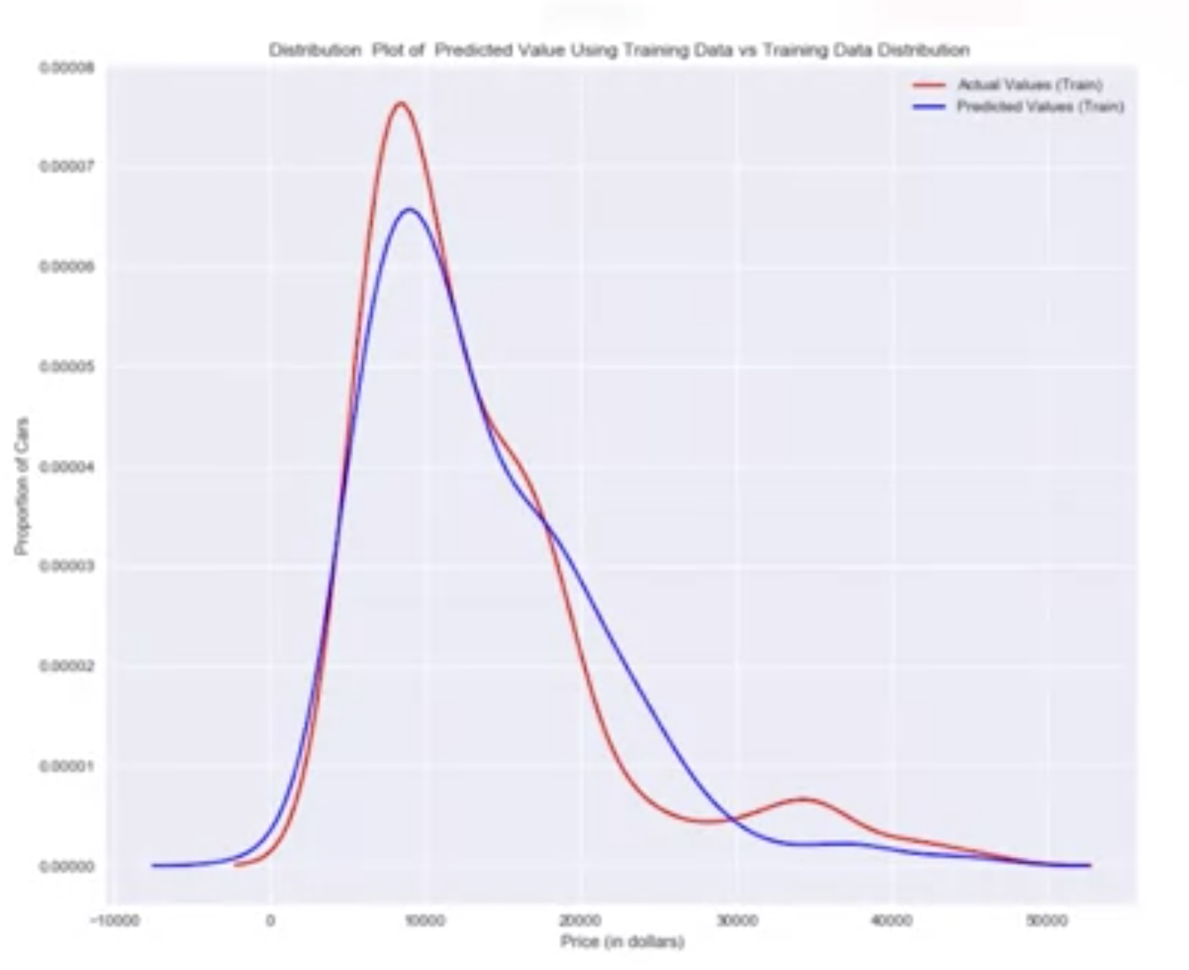
Model Evaluation and Refinement
Generalization error is a measure of how well our data does at predicting previously unseen data.
Data science steps
Notes:
The error we obtain using our testing data is an approximation of this error. This figure shows the distribution of the actual values in red compared to the predicted values from a linear regression in blue

Slide 21
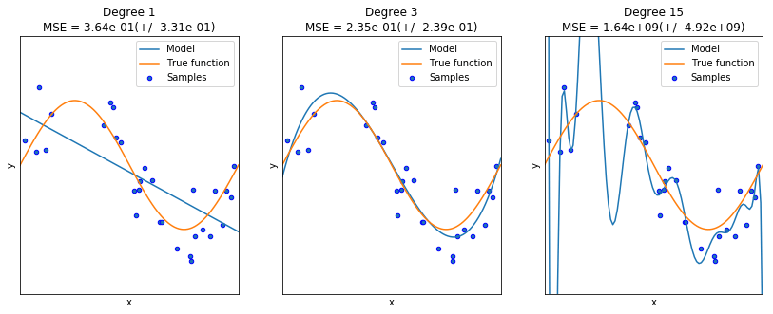
Model Evaluation and Refinement
Using a lot of data for training, gives us an accurate means of determining how well our model will perform in the real world.
Validation:
  Underfitting
  Good Fitting
  Overfitting
Data science steps

Slide 22
Summary
Understand import datasets
Understand data wrangling
Understand exploratory data analysis
Understand model development
Understand model evaluation and refinement
Data science steps

Slide 23
Q & A
Data science steps

